Slide 1
Name
Tutor
Institution
Date

Slide 2
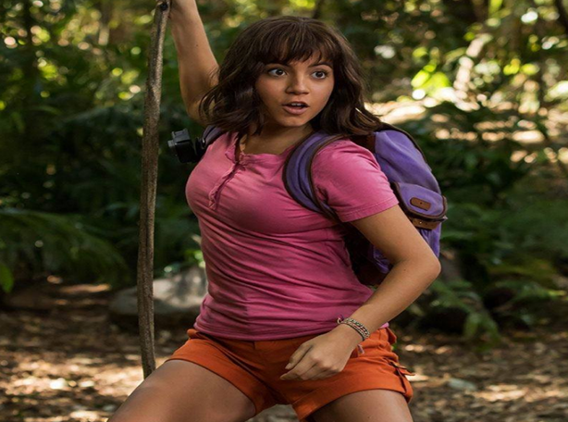

Parapata (film)
Genre: Adventure
Film: Parapata
Characters Dora, her parents, school mates and a bunch of thieves all take journey to Parapata
There is a lot of adventure on their way to Parapata (DORA found the Parapata, n.d).
Notes:
Characters Dora, her parents, school mates and a bunch of thieves all take journey to Parapata. There is a lot of adventure on the way and after they reach Parapata (DORA found the Parapata, n.d).

Slide 3
Genre: Musical
Film: parapata
Dora and his school mates performs a music to rejoice their safety
Notes:
Dora and his school mates performs and enjoys music to rejoice their safety.

Slide 4
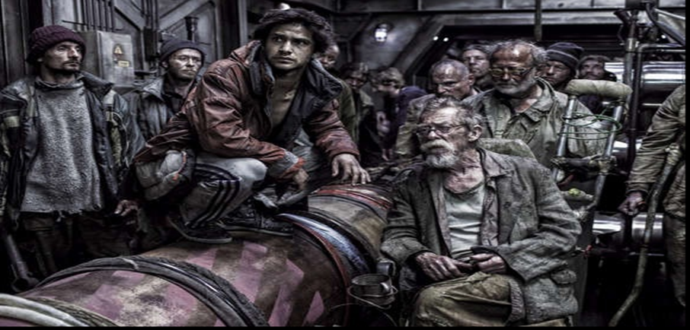
Genre: science fiction film: snow piercer
There is a lot of technology embraced as a group of socially stratified people journey in a special train known as Snow-piercer (Snowpiercer ,2013) .
The train is ever moving and saves humanity from frozen world.
It embrace science for human survival
Notes:
There is a lot of technology embraced as a group of socially stratified people journey in a special train known as Snow-piercer (Snowpiercer ,2013) . The train is ever moving and saves humanity from frozen world. It embrace science for human survival

Slide 5
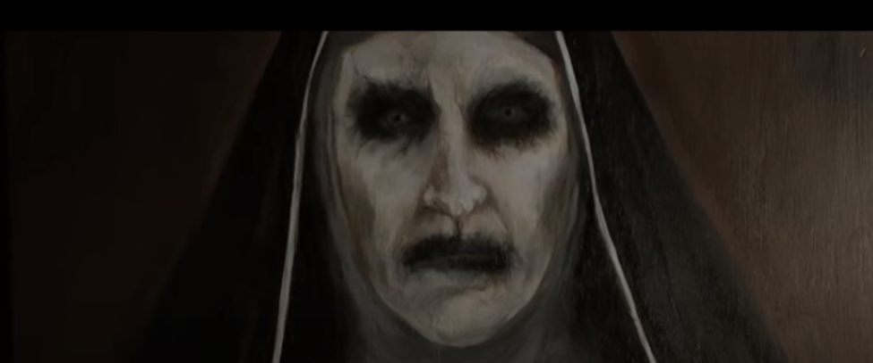
Genre: Horror film: The nun
The Nun is a horror film which explores dark worship (“The Nun Full Movie English Horror (HD)” n.d).
In the convent one of the nun is an evil spirit that kills fellow nuns and anybody who trespass the compound.
The movie arouse the feeling of fear due to the mysterious deaths of people.
Notes:
The Nun is a horror film which explores dark worship (“The Nun Full Movie English Horror (HD)” n.d). In the convent one of the nun is an evil spirit that kills fellow nuns and anybody who trespass the compound. The movie arouse the feeling of fear due to the mysterious deaths of people.

Slide 6
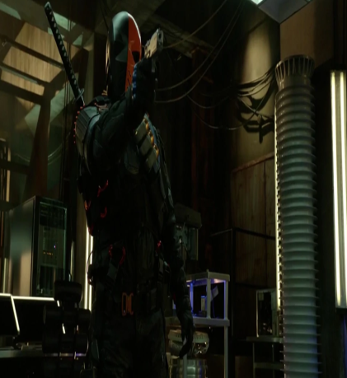
Genre: Thiller/murder
The movie is based on crusade of Oliver Queen who comes to restore peace and fight corruption in Starling City.
There is a lot of murder, especially by bad guys who terrorize innocent civilians (Iaccino et al. (Eds.). (2017).
Characters like Slade, Malcolm Merlyn, Oliver Queen, Sara Lance, and mercenaries like Lisa perpetuate murder.
Notes:
The movie is based on crusade of Oliver Queen who comes to restore peace and fight corruption in Starling City. There is a lot of murder, especially by bad guys who terrorize innocent civilians (Iaccino et al. (Eds.). (2017). Characters like Slade, Malcolm Merlyn, Oliver Queen, Sara Lance, and mercenaries like Lisa perpetuate murder.

Slide 7
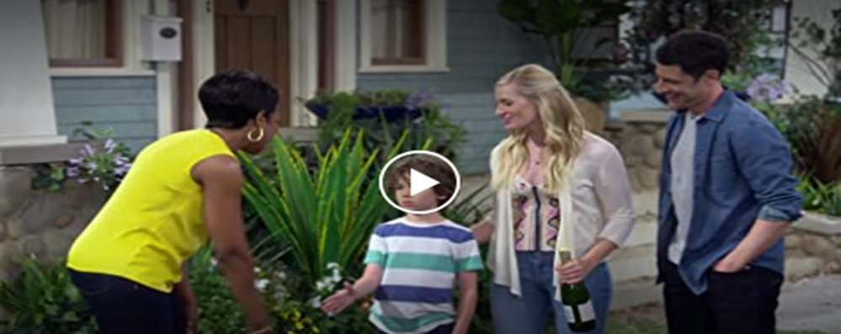
Genre: Drama
TV series: Neighborhood
Calvin Butler thinks that the Dave Jackson’s family will change the culture of the blacks in L.A.
All talks are sarcastic as each person tries to attack the weakness of the other.
Notes:
('The Neighborhood' Renewed For Season 2.” n.d). Calvin Butler thinks that the Dave Jackson’s family will change the culture of the blacks in L.A. All talks are sarcastic as each person tries to attack the weakness of the other. The whole comedy is educative.

Slide 8
Genre: comedy
TV series: neighborhood
The Neighborhood is a TV series with a lot of comedy from humorous talks between the family of Dave Johnson and that of Calvin Butler ('The Neighborhood' Renewed For Season 2.” n.d).
The whole comedy is educative
Notes:
The Neighborhood is a TV series with a lot of comedy from humorous talks between the family of Dave Johnson and that of Calvin Butler

Slide 9
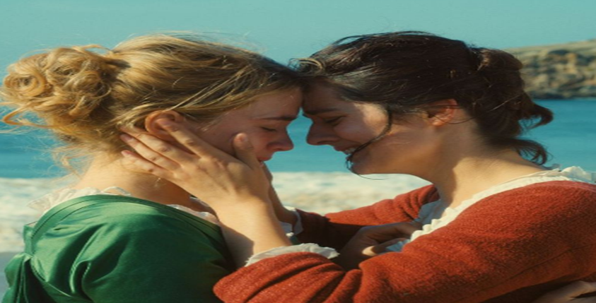
Genre: Romance film: Portrait of a lady in fire
Marianne, a painter is commissioned to paint a wedding portrait of Heloise.
She is supposed to stay close to her by day and paint the image by night (“Portrait of a Lady on Fire Trailer #1, 2019) .
Due to their being close, Marianne and Heloise falls in love.
Notes:
Marianne, a painter is commissioned to paint a wedding portrait of Heloise. She is supposed to stay close to her by day and paint the image by night (“Portrait of a Lady on Fire Trailer #1, 2019) . Due to their being close, Marianne and Heloise falls in love.

Slide 10
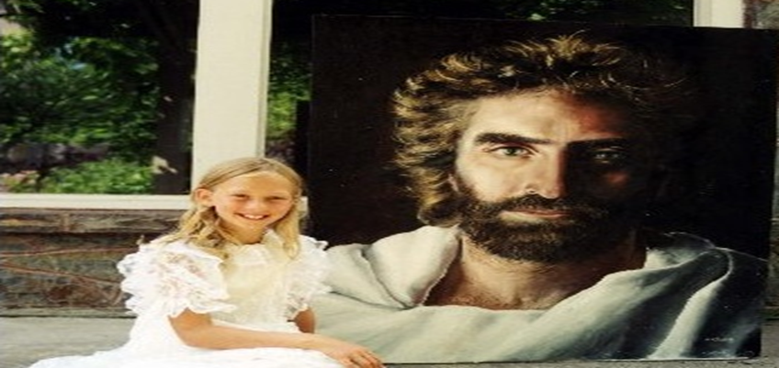
Genre: biblical
Film: heaven is for real
The movie is based on vision of a boy who dies and resurrect while the doctors are performing operation on him.
During his “deep sleep” he journeys to heaven and meets Jesus Christ and long dead people.
He sees his long dead grandfather and sister (“Heaven is for Real” n.d) .
When he resurrects and tells his father about heaven, the father spread the gospel about heaven to his fellow church men who in their disbelief denounces him.
Notes:
The movie is based on vision of a boy who dies and resurrect while the doctors are performing operation on him. During his “deep sleep” he journeys to heaven and meets Jesus Christ and long dead people. He sees his long dead grandfather and sister (“Heaven is for Real” n.d) . When he resurrects and tells his father about heaven, the father spread the gospel about heaven to his fellow church men who in their disbelief denounces him.

Slide 11
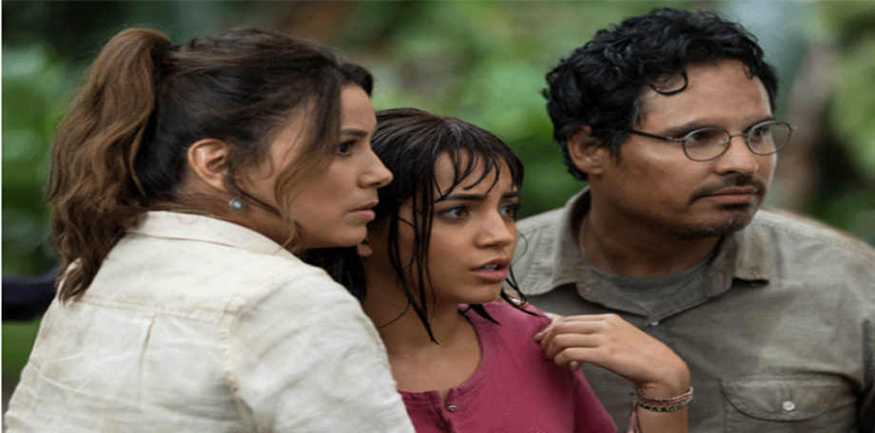
Genre: Animation film: parapata
Every person in the group sees the other as a cartoon. The whole scene is animated.
They also experience fantasy in their animated form.
Notes:
Dora’s group pass through a place where they are not supposed to touch anything but the man accidentally touches a flower (DORA found the Parapata, n.d). Every person in the group sees the other as a cartoon. The whole scene is animated. They also experience fantasy in their animated form.

Slide 12

Genre: fantasy
Dora’s group pass through a place where they are not supposed to touch anything but the man accidentally touches a flower (DORA found the Parapata, n.d).
There is fantasy experience in the animated form
Notes:
Dora’s group pass through a place where they are not supposed to touch anything but the man accidentally touches a flower (DORA found the Parapata, n.d). Every person in the group sees the other as a cartoon. The whole scene is animated. They also experience fantasy in their animated form.

Slide 13
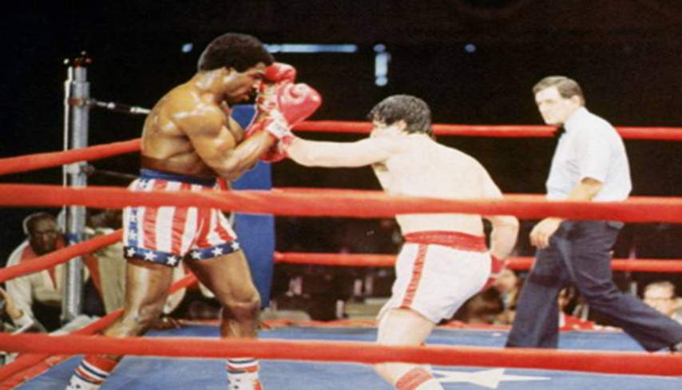
Genre: sport based film: The creed
The film is based on the ambitions of Adonis Johnson of wanting to follow the footsteps of his late father, Apollo Creed.
Adonis is mentored by former heavyweight boxing champion, Rocky Balboa (“CREED 2, n.d).
The entire film is on boxing
Notes:
The film is based on the ambitions of Adonis Johnson of wanting to follow the footsteps of his late father, Apollo Creed. Adonis is mentored by former heavyweight boxing champion, Rocky Balboa (“CREED 2, n.d). The entire film is on boxing.

Slide 14


Genre: Animal Based film: Zootopia
The film is based on the story of character Jude (she rabbit) that aspires to become a police.
She joins police force and she is posted to serve in Zootopia city (Zootopia, 2016).
All characters are animals and the film ridicules the fact that although animals have civilized There are still among them a group of animals that still are “animals.”
Notes:
The film is based on the story of character Jude (she rabbit) that aspires to become a police. She joins police force and she is posted to serve in Zootopia city (Zootopia, 2016). All characters are animals and the film ridicules the fact that although animals have civilized There are still among them a group of animals that still are “animals.”

Slide 15
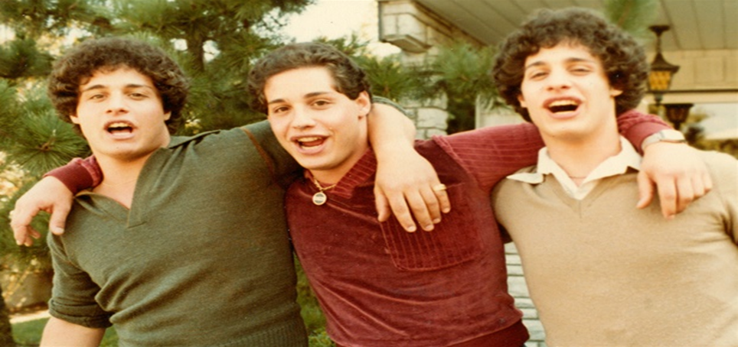
Genre: Documentary
Film: Three complete strangers
The film is based on true story of three strangers who met and later found that they were triplets.
The setting of the film is in New York in 1980 (“Three Identical Strangers Trailer #1 ,2018).
The film is meant to show the extra-ordinary nature of human beings.
Notes:
The film is based on true story of three strangers who met and later found that they were triplets. The setting of the film is in New York in 1980 (“Three Identical Strangers Trailer #1 ,2018). The film is meant to show the extra-ordinary nature of human beings.

Slide 16
References
References
Iaccino, J. F., Barker, C., & Wiatrowski, M. (Eds.). (2017). Arrow and Superhero Television: Essays on Themes and Characters of the Series. McFarland.
'The Neighborhood' Renewed For Season 2.” Retrieved from: https://www.youtube.com/watch?v=zhbGsTorsQk&list=PL4lAyRe-CijbUL6iMlZxhUGoHfZwlWnQn
The Nun Full Movie English Horror (HD). Retrieved from: https://www.youtube.com/watch?v=Atezv9OM3Bg
Three Identical Strangers Trailer #1 (2018) | Movieclips Indie. Retrieved from: https://www.youtube.com/watch?v=c-OF0OaK3o0
Portrait of a Lady on Fire Trailer #1 (2019) | Movieclips Indie. Retrieved from: https://www.youtube.com/watch?v=6sS4_CPqmY0
Snowpiercer (2013) Full Movie HD [1080p]. Retrieved from: https://www.youtube.com/watch?v=PAuUTbkkwEU
DORA found the Parapata | Dora and the Lost City of Gold | Movie Clip. Retrieved from: https://www.youtube.com/watch?v=17Jrel1xaXE
Zootopia 2016 Full Movie Compilation - Animation Movies For Children - Disney Cartoon 2019. Retrieved from: https://www.youtube.com/watch?v=3pSytIZ7s9s
Heaven is for Real Full Movie. Retrieved from: https://www.youtube.com/watch?v=gBpwSAO9Iq0
CREED 2 - CREED VS DRAGO (FINAL FIGHT). Retried from: https://www.youtube.com/watch?v=8

